Slide 1

Strategic Plan and CRM Solution for Tool Time Expanding in the New England Region
CONSULTANT – Srishti Shetty

Slide 2
Content
Background
Purpose of the Strategy and CRM Solution
Analyzing Competitor Strategies
Planning
Strategy
Locations
CRM
Implementation approach
Analytical Solution
New Technology Innovations

Slide 3
Background
Home improvement store
Headquarters in downtown Essex
15 stores with 1500 employees, each doing well in revenue and profit
Specializes in home improvement and DIY supplies, catering to customers
Competitive advantage in small communities of New England.
Received multiple customer service awards, highlighting commitment to customer satisfaction.
Competitors – Lowes, Home Depot

Slide 4
Expand and become a franchise in the larger New England Region. The strategic plan will involve identifying potential store locations in untapped areas within the New England Region, drawing insights from the successful store placement strategies of Home Depot and Lowes. CRM solution will aim to intelligently manage customer relationships to drive revenue growth, enhance customer experience and support Tool Time's expansion goals. By developing a comprehensive strategy and CRM solution, Tool Time aims to capitalize on its strengths, differentiate itself in the market and pave the way for sustainable growth and success as a franchise in the competitive home improvement retail landscape of the New England Region.
Purpose of the Strategy and CRM Solution

Slide 5
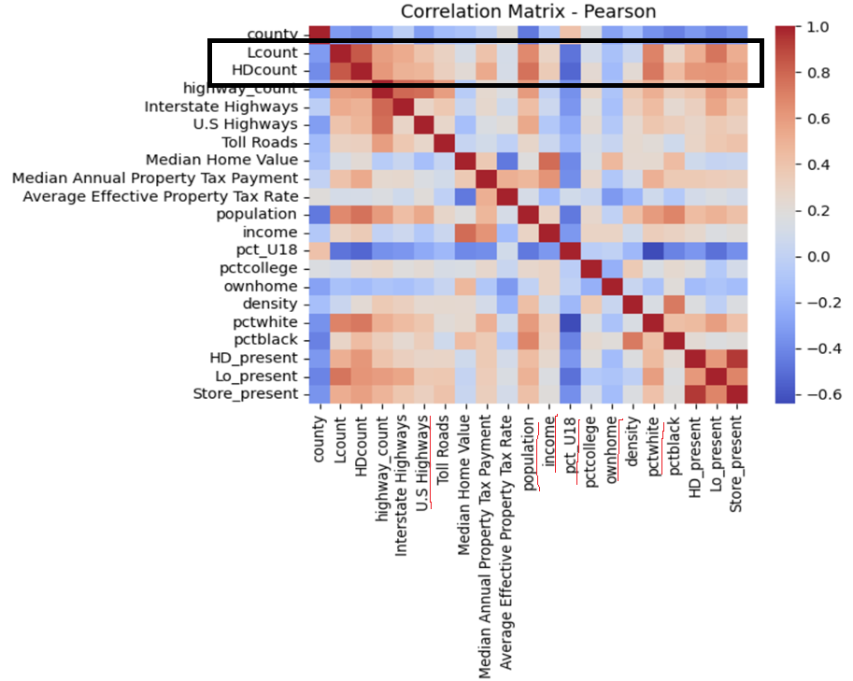
Analyzing Competitor Strategies
Population Correlation: Direct relation (high level)
Ethnic Demographics: Direct relation (high level)
Highway Accessibility: Direct relation (medium level)
Income Levels: Direct relation (medium level)
Homeownership: Indirect relation (medium level)
Youth Population: Indirect relation (high level)

Slide 6
Planning
STEP 1 - Using census 2000 and 2010 data, calculated percentage increase within 10 years for various variables like population, income, homeownership, etc for all county’s in New England region.
STEP 2 – Calculated mean for all these variables to create a reference to analyze.
STEP 3 – Excluded county’s where there is already a presence of competitor stores.
STEP 4 – Introduced new variable – “overall growth” by multiplying population and income. And sorted high to low based on this.
STEP 5 – Highways> 0 , pct_U18 <3
 | Lcount | HDcount | population | income | pct_U18 | pctcollege | ownhome | density | pctwhite | pctblack
count | 67 | 67 | 67 | 67 | 67 | 67 | 67 | 67 | 67 | 67
mean | 1.104478 | 1.716418 | 7841.3881 | 16056.1343 | 3.038806 | 3.623881 | 1.073134 | 25.38508 | 1.995522 | 0.116418
std | 1.558305 | 2.165892 | 10516.675 | 4443.46015 | 0.970154 | 1.335992 | 0.944615 | 88.54244 | 1.440058 | 0.191957
min | 0 | 0 | 0 | 7467 | 0.7 | 0.4 | 0.1 | 0 | 0.2 | 0
25% | 0 | 0 | 943 | 12961 | 2.6 | 2.8 | 0.4 | 1.7 | 1 | 0
50% | 0 | 1 | 3292 | 15380 | 3 | 3.8 | 0.8 | 6.1 | 1.4 | 0
75% | 2 | 2.5 | 10304.5 | 19044 | 3.55 | 4.4 | 1.5 | 24.2 | 2.55 | 0.1
max | 6 | 9 | 47589 | 30214 | 6.6 | 7.1 | 4.8 | 724.1 | 6.7 | 1.1

Slide 7
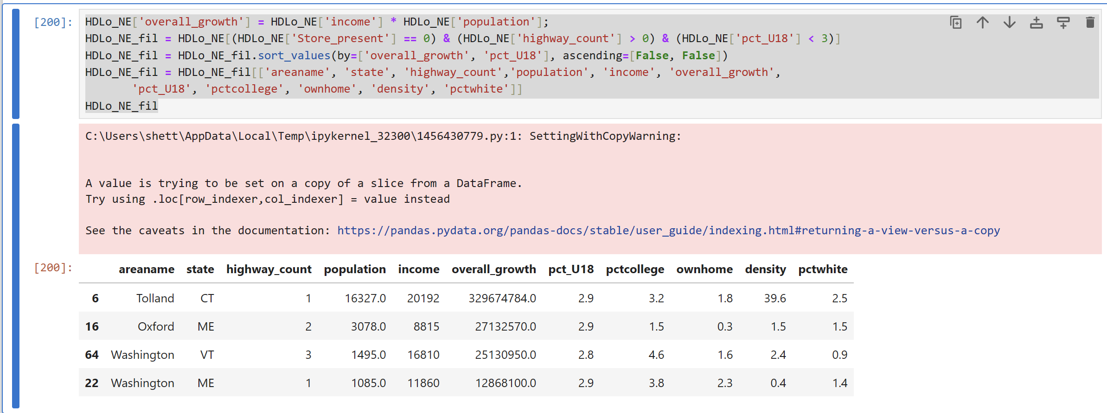
STRATEGY
Locations

Slide 8
LOCATIONS
Tolland: Characterized by significantly high population and income levels, Tolland emerges as a top contender. With one highway facilitating accessibility and a relatively average presence of colleges, Tolland presents an opportune environment for Tool Time's expansion. Additionally, the compact density of Tolland suggests logistical advantages, enabling efficient delivery operations and potentially reducing transportation costs.
Oxford: Situated in Maine, Oxford showcases commendable overall growth and boasts two highways, making it an appealing location for Tool Time's expansion efforts.
Washington: The county of Washington in Vermont also warrants serious consideration for Tool Time's new store. Despite experiencing a below-average population increase over the past decade, Washington demonstrates a remarkable doubling of income levels, surpassing the regional average. With three highways facilitating transportation and above-average college presence suggesting seasonal spikes in demand for home improvement products, it presents an enticing opportunity for Tool Time's expansion strategy.

Slide 9
CRM
Identify New Prospects - Use data analytics and market research to find potential prospects. Segment prospects based on demographics, preferences and purchasing behavior. Establish partnerships with local contractors to expand the customer base. Collaborate on marketing campaigns and referral programs through contractor networks. Offer special discounts and assistance to college students seeking home improvement products.
Track and Monitor Sales Opportunities - Implement a robust CRM system to effectively track and monitor sales opportunities. Capture leads from multiple channels like website inquiries, social media and in-store visits, and monitor their progress through the sales pipeline. Utilize sales automation tools to streamline processes, set reminders for follow-ups, and track interactions with prospects for timely and personalized communication.
Organize and Engage Current Customers – Host exhibitions and engaging events to showcase new products and offer exclusive discounts. Provide interactive sessions and demonstrations for enhanced customer experience. Leverage social media and email marketing to promote events and encourage participation. Offer comprehensive installation assistance and personalized consulting services.
Establish a Relationship with Current Customers - Continuously revise marketing strategies based on environment and customer preferences. Stay updated with industry trends and adapt marketing campaigns accordingly. Utilize customer feedback and data analytics for personalized communication. Focus on enhancing the customer experience through personalized assistance.
Manage Customer Life Cycle - Implement customer-friendly return and replacement policies. Ensure a hassle-free process for returns, exchanges, and refunds. Track customer purchases and preferences for personalized recommendations. Offer incentives like discounts and free shipping to increase average order value.

Slide 10
Phase 1 - Data Collection and Integration: Let's gather customer data from existing stores. Perform data cleaning, transformation and normalization and then integrate with existing IT systems. Establish data pipelines for seamless data flow. Phase 2 - CRM Platform Selection and Customization: Evaluate CRM platforms based on Tool Time's requirements. Customize the selected CRM platform to align with Tool Time's processes and workflows. Configure modules for prospect management, sales tracking, customer engagement and lifecycle management. Phase 3 - Training and Adoption: Train staff on CRM usage. Foster a customer-centric culture. Implement change management strategies to overcome resistance and drive user acceptance. Phase 4: Testing: Roll out the CRM solution in a pilot environment to a select group of users. Collect input from users to gain valuable feedback and insights, enabling to pinpoint areas for enhancement. Phase 5: Full Deployment and Integration: Scale up the CRM solution across all departments and locations of Tool Time. Integrate the CRM system with existing IT infrastructure, including databases, applications and analytics tools. Ensure seamless communication and data exchange between CRM and other systems. Phase 6: Segmentation and Personalization: Categorize customers based on behavior and demographics. Personalize marketing messages. Phase 7: Engagement and Retention: Implement loyalty programs. Regularly engage through email, social media and in-store events. Enable social listening capabilities to identify opportunities for engagement and address customer inquiries or concerns. Leverage social media analytics to track brand mentions, trends and competitive insights.
Implementation Approach

Slide 11
Analytical Solution for CRM
- Utilize a comprehensive data analytics platform for Tool Time's CRM solution.
- Develop customized reports and dashboards to visualize CRM data and metrics.
- Integrate various data sources like customer interactions, sales data and market trends.
- Establish a centralized data warehouse to store and analyze customer data.
- Implement advanced data analytics techniques such as machine learning algorithms.
- Enable real-time reporting and analytics for timely decision-making.
- Incorporate risk assessment functionalities to identify and mitigate potential risks.
- Analyze factors like customer satisfaction scores, purchase history and market volatility.
- Regularly update and enhance the analytics platform with new features and security patches.

Slide 12
New Technology Innovations and Data Sources
- Implement robust data migration tools and pipelines for streamlined data transfer.
- Embrace modern data architecture principles like data lakes or data hubs for seamless integration.
- Prioritize robust data privacy measures and compliance with regulations like GDPR.
- Incorporate ethical AI principles into predictive models to mitigate biases.
- Establish data governance policies to govern the collection, storage and processing of customer data.
- Deploy multi-layered security measures to safeguard CRM data against unauthorized access.
- Utilize role-based access controls to ensure data confidentiality and integrity.
- Conduct regular security audits and vulnerability assessments to address potential risks.
- Evaluate cloud-based versus on-premises CRM solutions for optimal deployment.
- Prioritize customer satisfaction through innovative technologies and data-driven approaches.
- Leverage data analytics to achieve sustainable growth and success.
- Embrace technological advancements to achieve expansion and business objectives.

Slide 13
Thank You!

